Slide 1
Finlatics
Data Science Project
By: Suryanshu

Slide 2
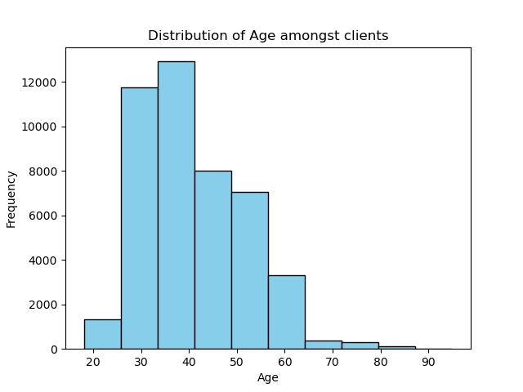
Age Distribution
Median age is 39.

Slide 3
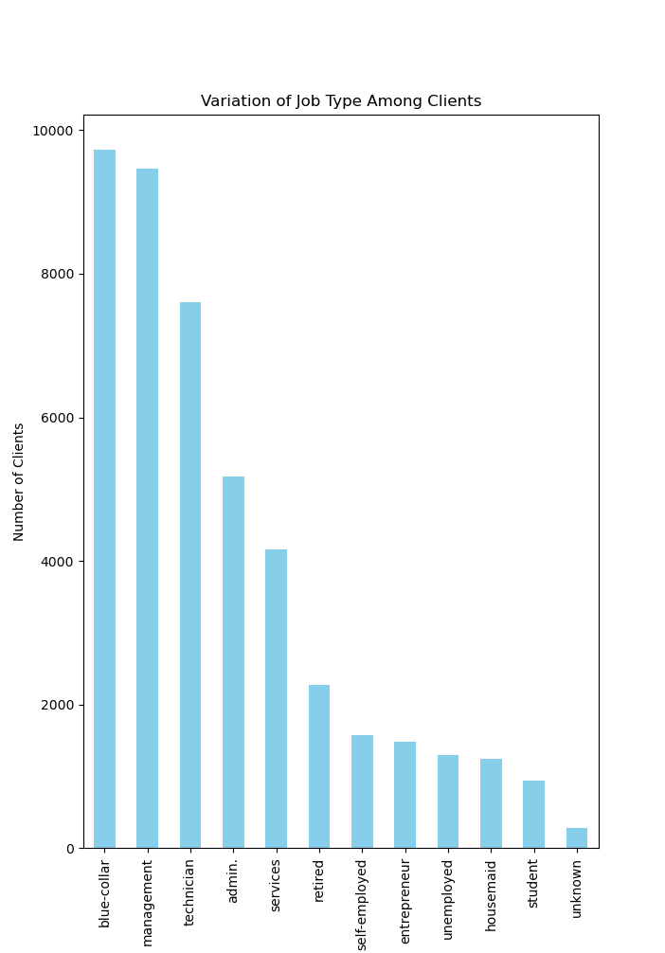
Job Type
Mode is Blue Collar jobs with 9732 clients

Slide 4
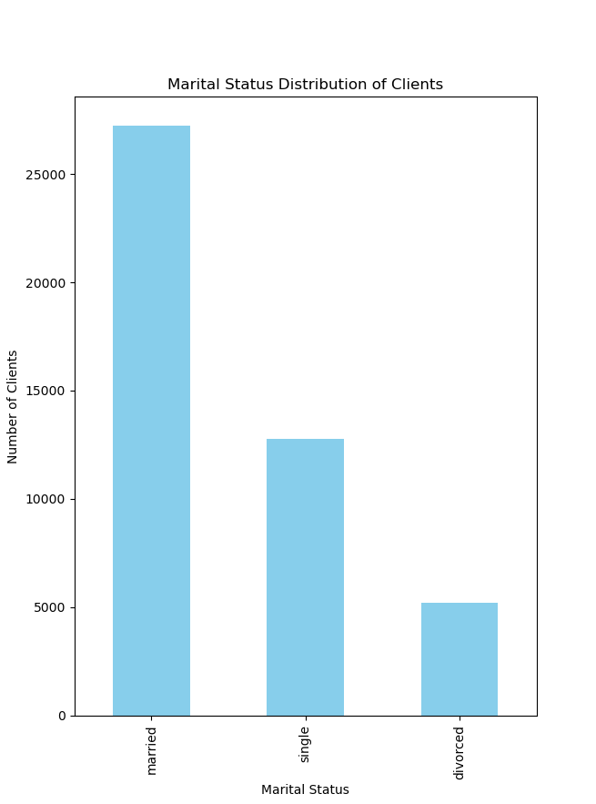
Marital Status
Mode is married with 27216 clients married.

Slide 5
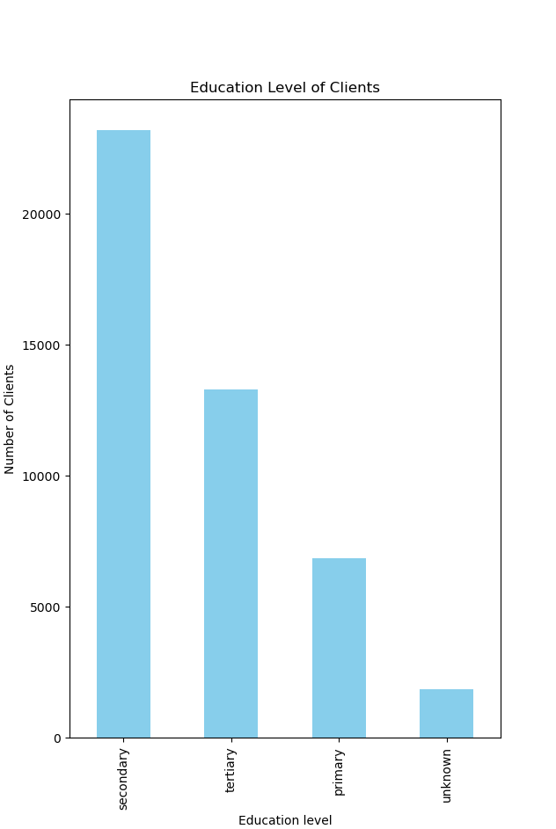
Education Level
Mode is Secondary education with 23204 clients.

Slide 6
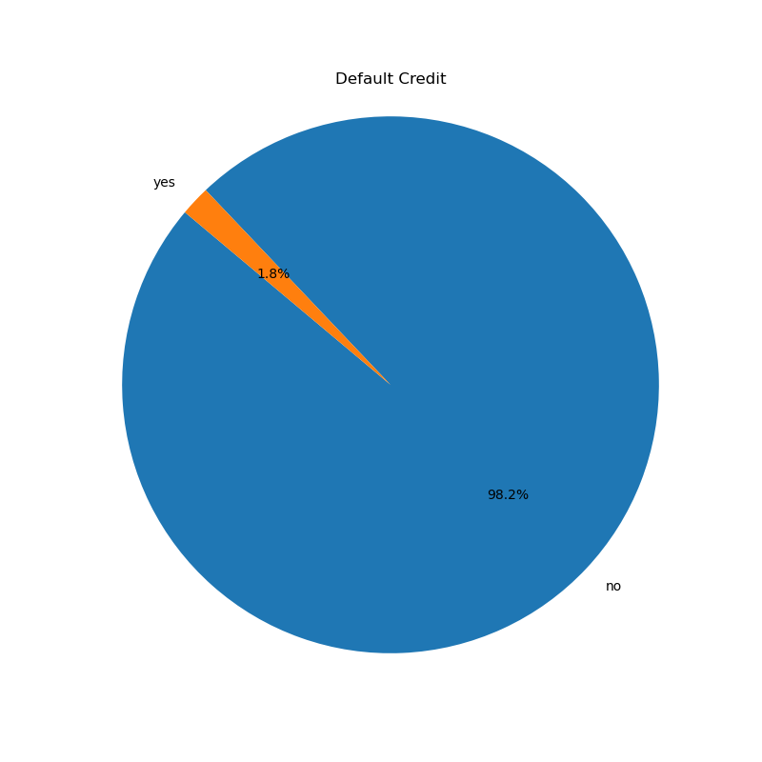
Default Credit
815 clients have their credit in default.

Slide 7
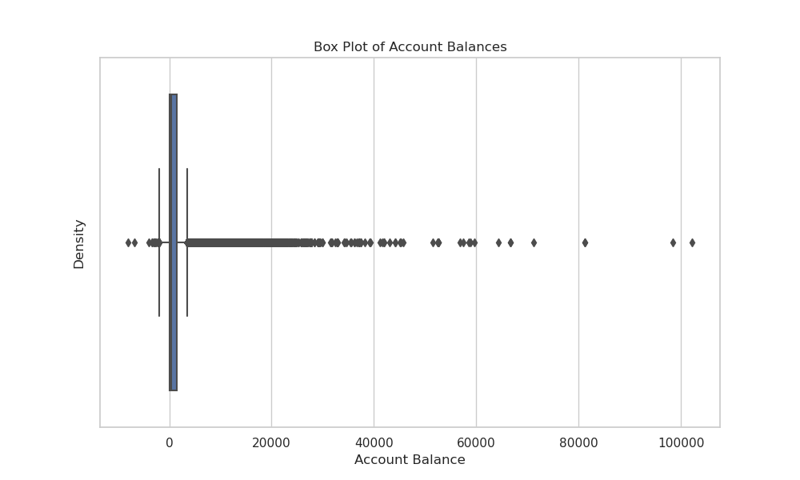
Balance
Median balance is 448.5

Slide 8
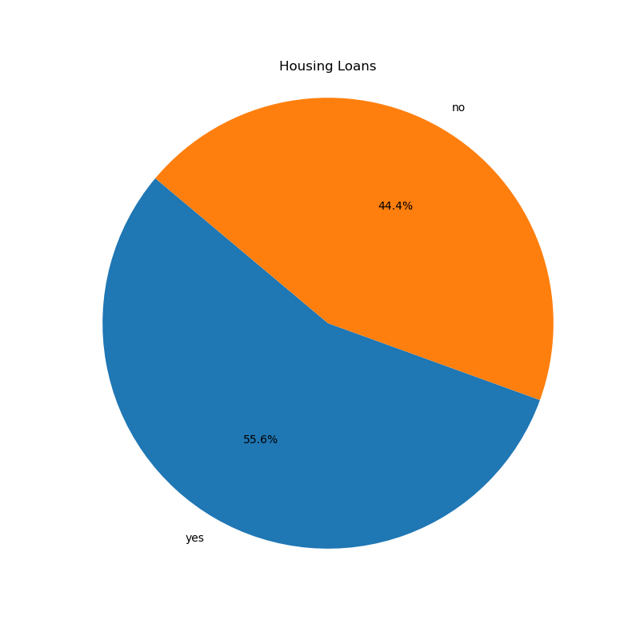
Housing Loans
25130 clients have housing loans.

Slide 9
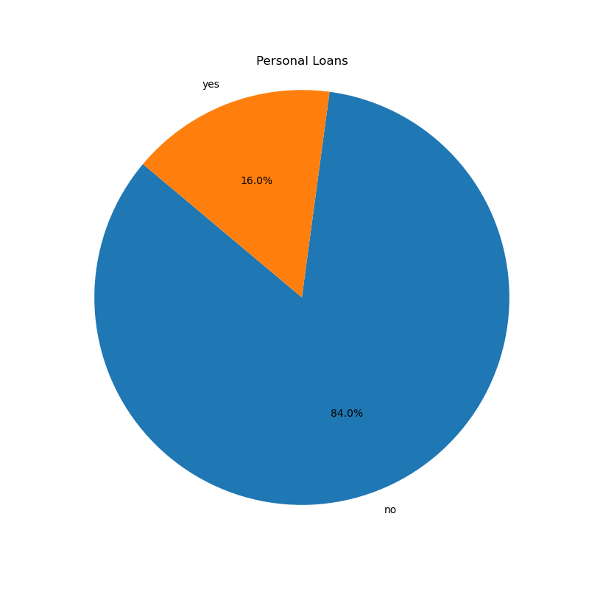
Personal Loans
7244 clients have personal loans.

Slide 10
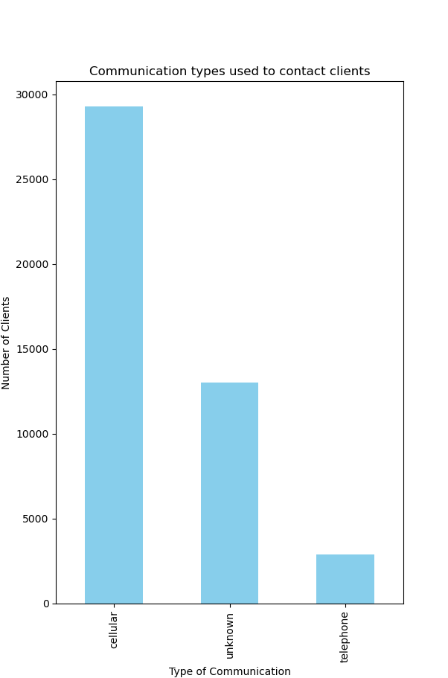
Communication Type
Cellular is the most popular means of contact (29290)

Slide 11
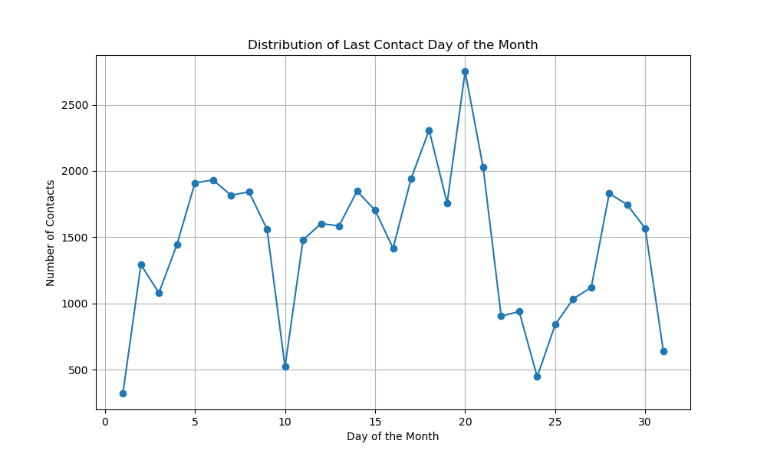
Last contact Day
Mode is 20.

Slide 12
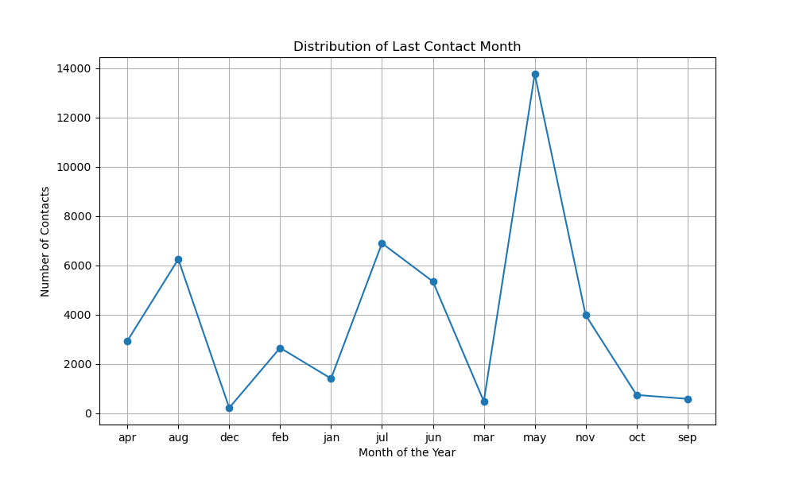
Last Contact Month
May is the mode.

Slide 13
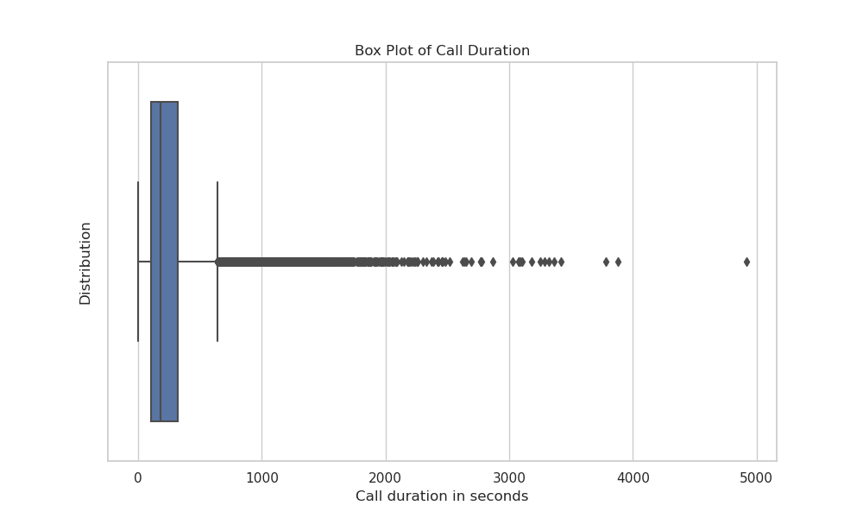
Duration of the last contact
180s is the median.

Slide 14
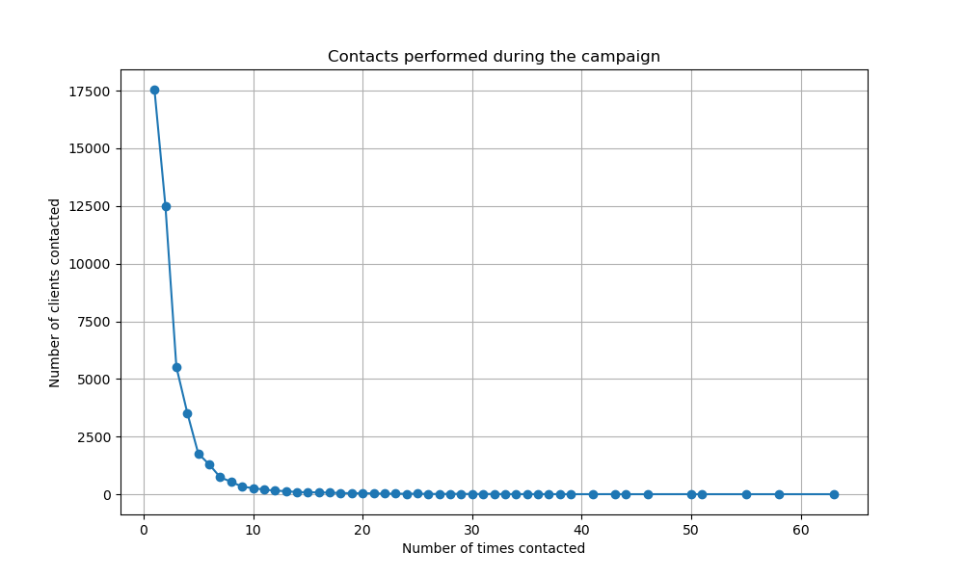
Number of contacts performed
2 is the median.

Slide 15
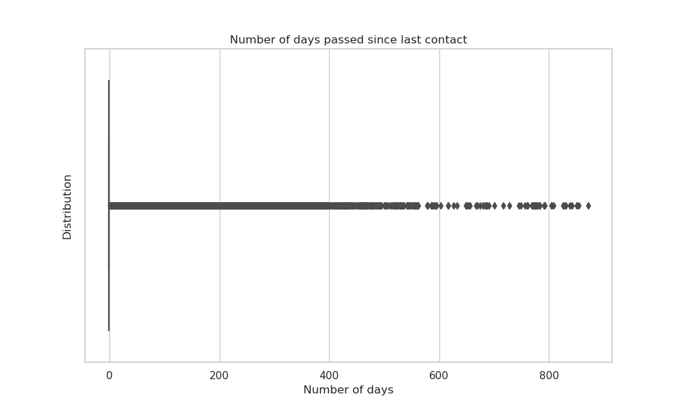
Days passed since previous contact
-1 is the median, hence for most of the clients,
there was no recontact.

Slide 16
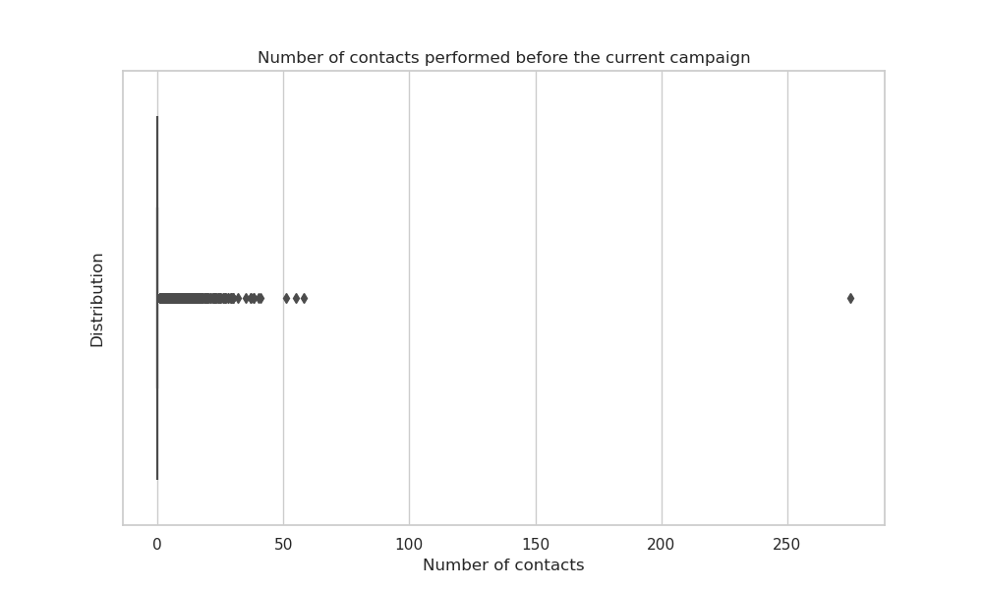
Contacts performed before the current campaign
Median is 0.

Slide 17
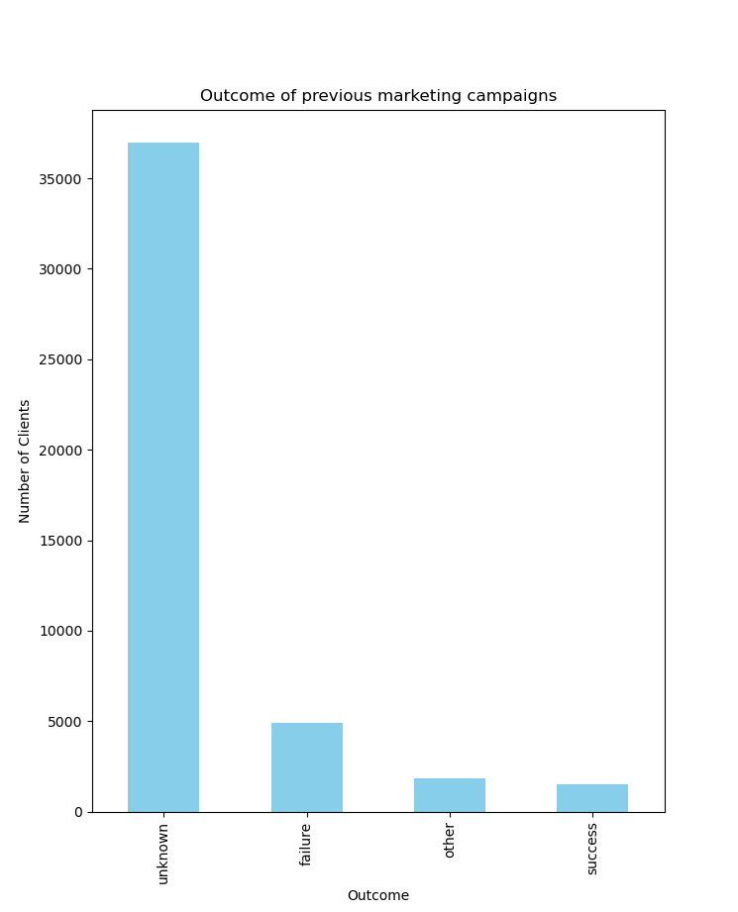
Outcome of the previous campaign
Mode is unknown with 36961.

Slide 18
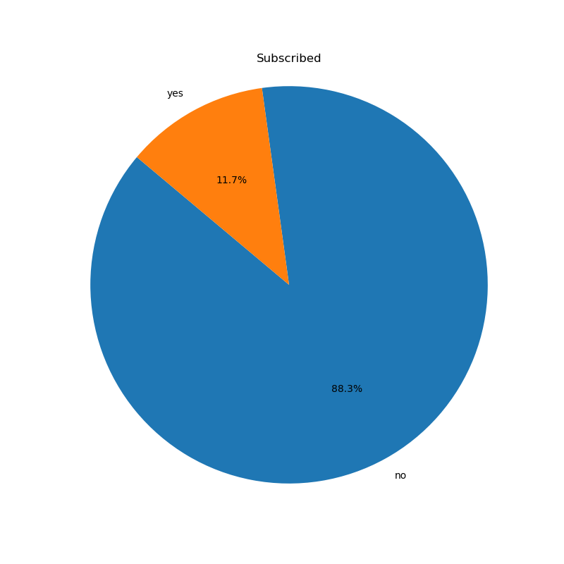
Subscribed Term Deposit
39922 people did not subscribe to a term deposit.

Slide 19
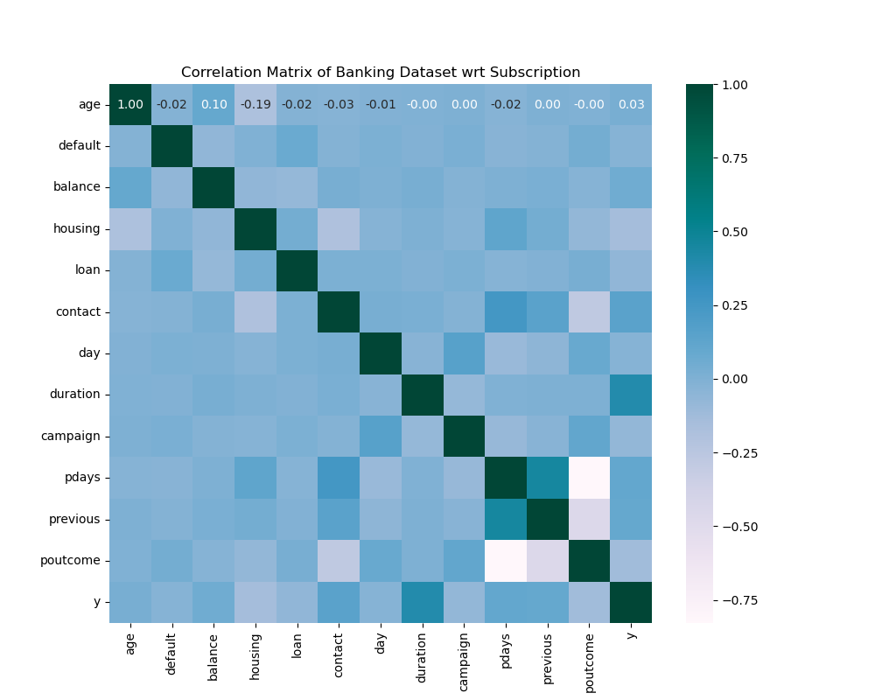
Correlation bw different attributes and subscription
This shows that the subscription variable is not highly
dependent on one particular attribute, though the
strongest (mild) relation is with call duration with a
correlation of 0.39

Slide 20
Thank You

